Slide 1
Assignment 8
Group 38
Jake Back, Harry Cho

Slide 2
Objectives
DEMO
Client / Server system’s functionality
MongoDB
Metadata from Dataniz
Challenges & Solutions
Suggestions

Slide 3
DEMO

Slide 4
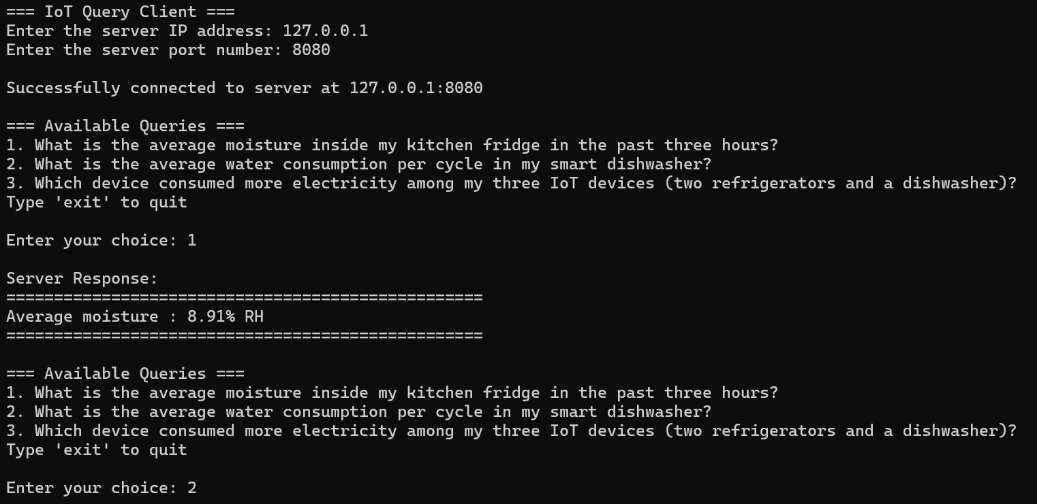
Client
Purpose:
Enables users to send queries to the server and retrieve results. Interactive user interface for query selection
Key Features:
Input: Accepts server IP and port (Menu display)
Query Validation: Only processes three predefined queries, rejecting invalid inputs with user-friendly messages

Slide 5
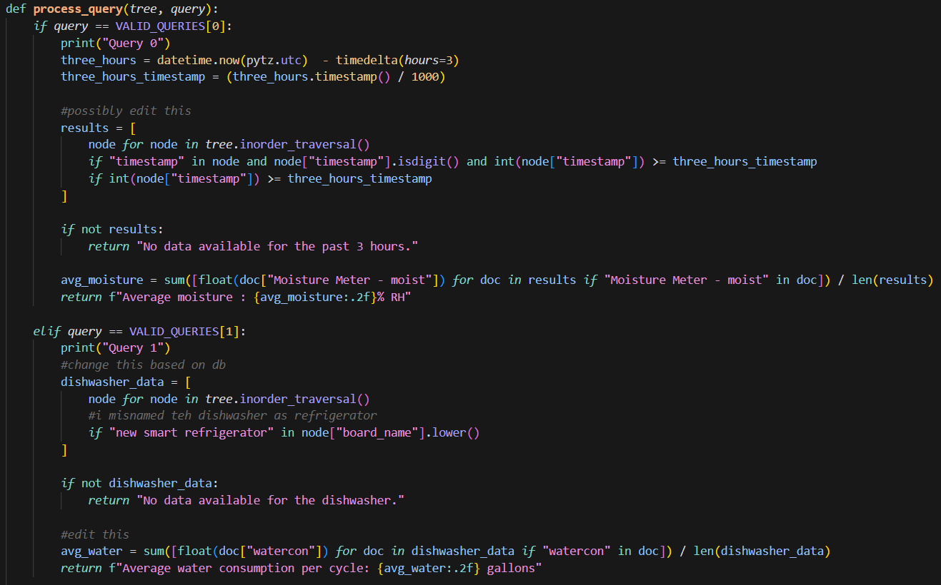
Server
Purpose:
Processes queries sent by the client and retrieves data from the database and performs calculations
Key Features:
Database Integration: Processes data stored in MongoDB
Data Structure: Implements a binary search tree for efficient query processing
Unit Conversion: Calculates RH%, gallons, kWh as units
BST: Efficient data sorting and searching (order data by timestamps like data from the last three hours)
Query Handling: Maps valid queries to processing functions

Slide 6
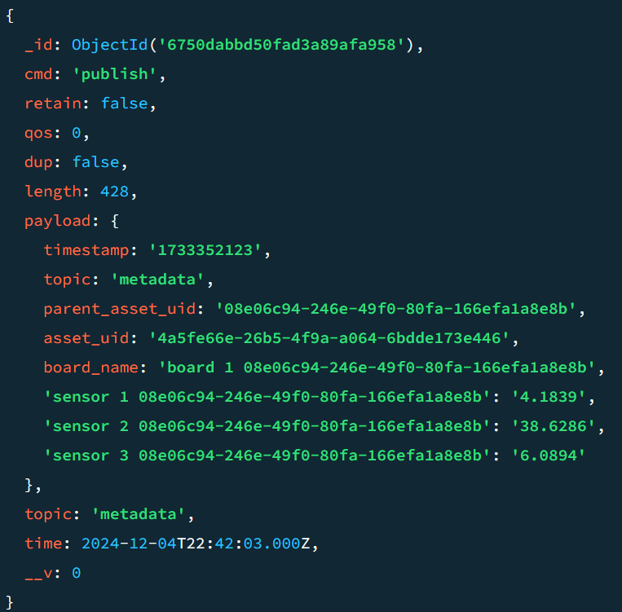
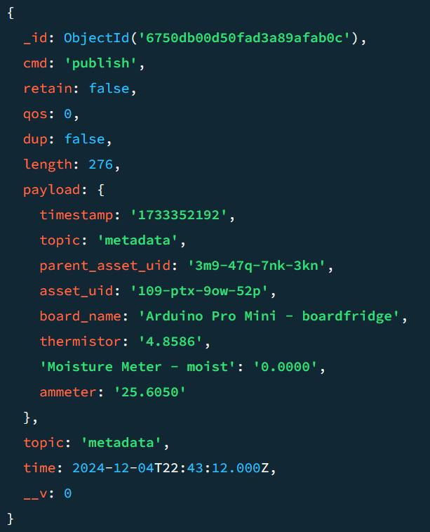
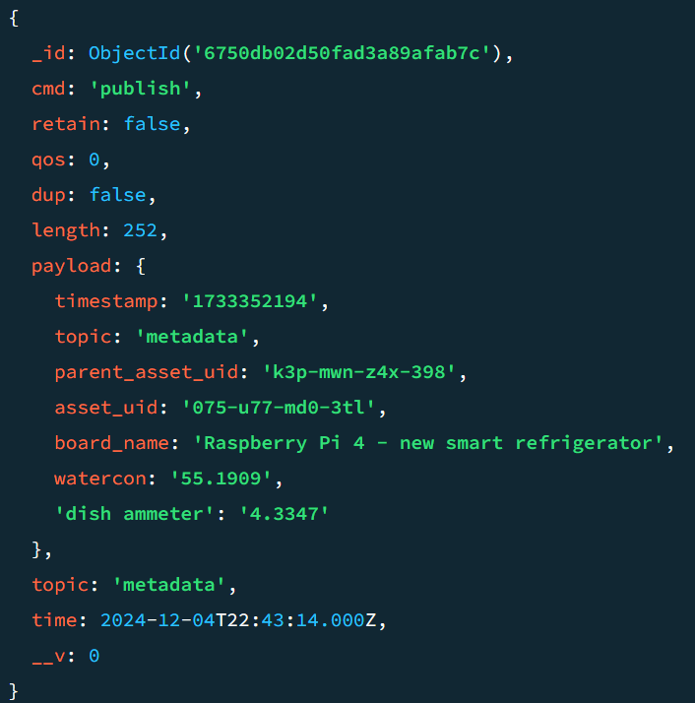
MongoDB

Slide 7
How metadata from dataniz was used to enhance the system
We mainly used metadata for location, and used device names to help answer our queries

Slide 8
Challenges & Solutions
Faced challenges getting dataniz to work properly ended up being trial and error
Getting the correct units from mongo to python (eg. timestamps) look into the mongo db to see the actual units and change accordingly
Users might input invalid queries or incorrect server details (IP, port)
A query validation mechanism that compares user input against a predefined list of valid queries
A retry mechanism for invalid IP or port inputs with user-friendly error messages
Server might be unavailable or connection could drop unexpectedly
Added error handling for ‘ConnectionRefusedError’ (Client)
Incorporated shutdown options (‘exit’) for better user experience. Otherwise, the program stays infinite
Searching through datasets stored in MongoDB could slow down response times
Implemented a binary search tree for in-memory data organization and efficient query processing
IoT device timestamps needed conversion to UTC, and data had to be in specific units (e.g., RH%, gallons, kWh)
Used pytz for precise timezone conversions.
Added functions for unit conversion and calculations (e.g., RH% computation from moisture).

Slide 9
Dataniz Suggestions
Not the easiest to use and fix errors if they do arise
Metadata must deleted through db not directly from dataniz
Add built in unit conversions for the sensors
Improve some UI & user-friendly tutorial for each sections

